Slide 1
VT Inspection
Data Analysis Report
2021 November 12

Slide 2
Dataset Summary
High Pressure blade, Low Pressure Blade and Casing component images were received from MHI
Dataset includes both defect and no-defect images for High Pressure(HP) Blade, Low Pressure(LP) Blade and Casing.
Summary of images received for each defect pattern for different components are given below
Component | Defect Pattern | No. of Defect images | No. of No-defect images
High Pressure Blade | ScratchDeformation | 103 | 4
 | ScaleDeposition | 131 | 18
 | Sealfinbend | 55 | 11
Low Pressure Blade | Erosion | 94 | 4
 | ErosioninSideLockPiece | 98 | 6
Casing | Sealfinbend | 107 | 4
 | DamageinFittingPorsion | 95 | 3

Slide 3
Dataset Summary – Out of scope images
Details of images discarded from original dataset based on latest review comment from MHI
Component | Defect Pattern | Images discarded by MHI | Similar type of images discarded by QuEST
High Pressure Blade | ScratchDeformation | 1 | 7
 | ScaleDeposition | 13 | 9
 | Sealfinbend | 4 | 1
Low Pressure Blade | Erosion | 2 | 0
 | ErosioninSideLockPiece | 12 | 13
Casing | Sealfinbend | 12 | 4
 | DamageinFittingPorsion | 0 | 0

Slide 4
Scratch and Deformation
The defect patterns are sub categorized based on the visual appearance

Slide 5
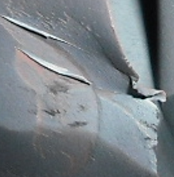
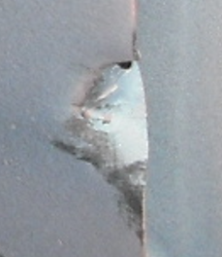

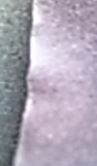
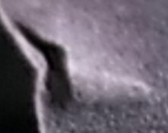
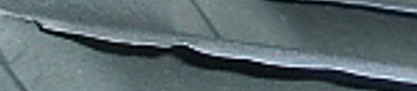
Deformation Type 1

Slide 6
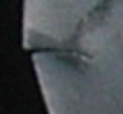
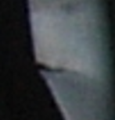
Deformation Type 2

Slide 7
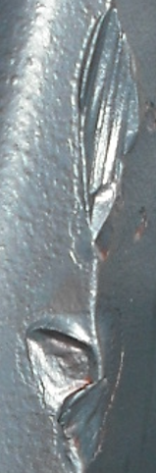
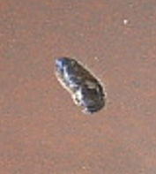
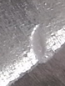
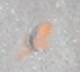
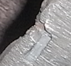
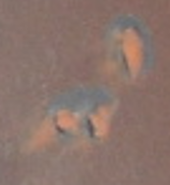
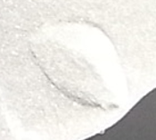
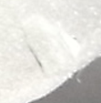
Deformation Type 3

Slide 8
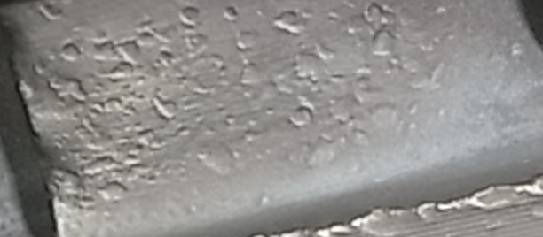
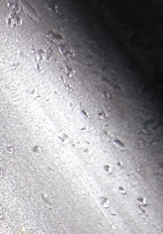
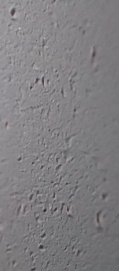
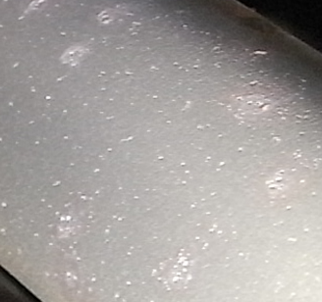
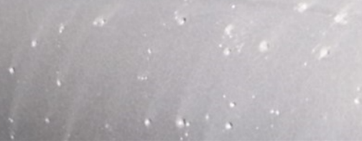
Deformation Type 4

Slide 9
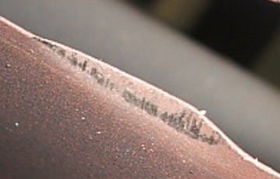
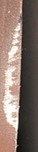
Deformation Type 5

Slide 10
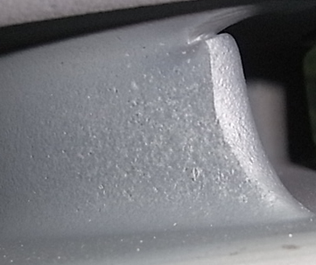
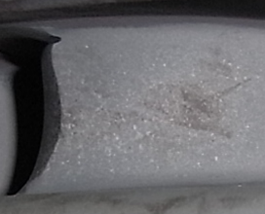
Deformation Type 6

Slide 11
Deformation Defect Pattern Frequency Distribution - Images

Slide 12
Deformation Defect Pattern Frequency Distribution - Region

Slide 13
Scale sedimentation
The defect patterns are sub categorized based on the visual appearance

Slide 14
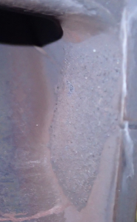
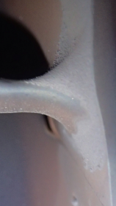
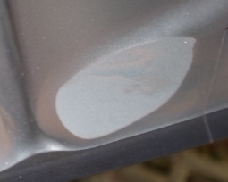
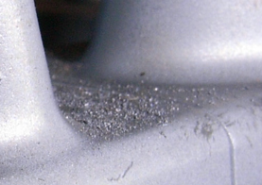
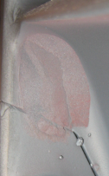
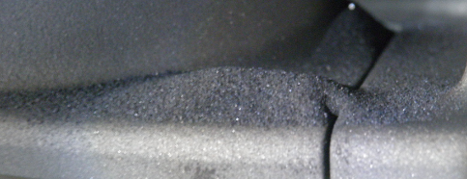
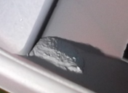
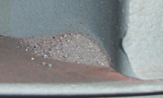
Scale sedimentation Type 1

Slide 15
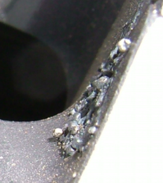
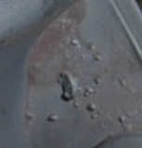
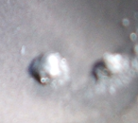
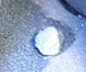
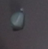
Scale sedimentation Type 2

Slide 16
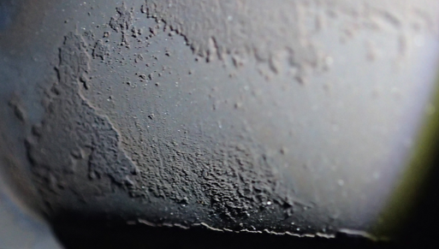
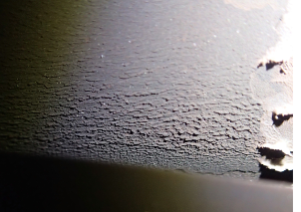
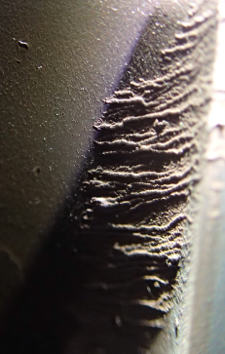
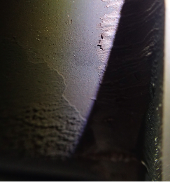
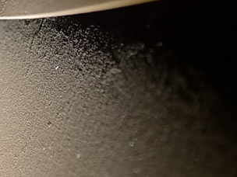
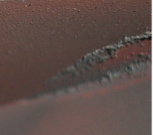
Scale sedimentation Type 3

Slide 17
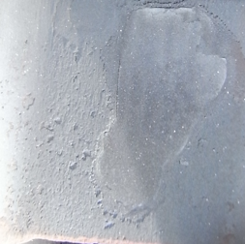
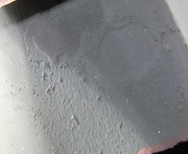
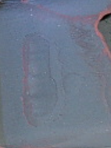
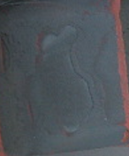
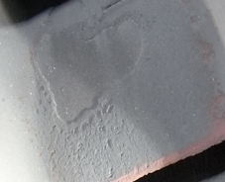
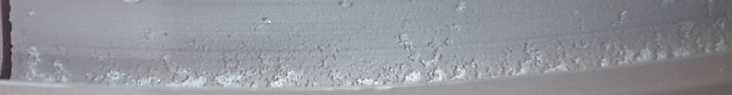
Scale sedimentation Type 3

Slide 18
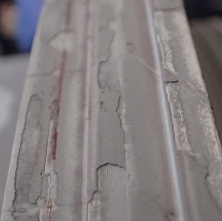




Scale sedimentation Type 4

Slide 19




Scale sedimentation Type 5

Slide 20
Scale Sedimentation Defect Pattern Frequency Distribution - Images

Slide 21
Scale Sedimentation Defect Pattern Frequency Distribution - Region

Slide 22
HP seal fin bend
The defect patterns are sub categorized based on the visual appearance

Slide 23









HP Seal Fin Bend - Type 1

Slide 24





HP Seal Fin Bend - Type 2

Slide 25


HP Seal Fin Bend - Type 3

Slide 26


HP Seal Fin Bend - Type 4

Slide 27
HP Seal Fin Bend Defect Pattern Frequency Distribution - Images

Slide 28
HP Seal Fin Bend Defect Pattern Frequency Distribution - Region

Slide 29
Erosion
The defect patterns are sub categorized based on the visual appearance

Slide 30







Erosion Type 1

Slide 31


Erosion Type 2

Slide 32








Erosion Type 3

Slide 33





Erosion Type 3

Slide 34










Erosion Type 4

Slide 35






Erosion Type 5

Slide 36



Erosion Type 6

Slide 37


Erosion Type 7

Slide 38



Erosion Type 8

Slide 39
Erosion Defect Pattern Frequency Distribution - Images

Slide 40
Erosion Defect Pattern Frequency Distribution - Region

Slide 41
Erosion in side lock piece
The defect patterns are sub categorized based on the visual appearance

Slide 42







Erosion in side lock piece Type -1

Slide 43

Erosion in side lock piece Type -2

Slide 44
Erosion in side lock Defect Pattern Frequency Distribution - Images

Slide 45
Erosion in side lock Defect Pattern Frequency Distribution - Regions

Slide 46
Casing seal fin bend
The defect patterns are sub categorized based on the visual appearance

Slide 47









Stationary part seal fin bend Type 1

Slide 48





Stationary part seal fin bend Type 2

Slide 49





Stationary part seal fin bend Type 3

Slide 50




Stationary part seal fin bend Type 4

Slide 51


Stationary part seal fin bend Type 5

Slide 52



Stationary part seal fin bend Type 6

Slide 53
Stationary part seal fin bend Defect Pattern Frequency Distribution – Images

Slide 54
Stationary part seal fin bend Defect Pattern Frequency Distribution – Regions

Slide 55
Damage in fitting portion
The defect patterns are sub categorized based on the visual appearance

Slide 56
















Damage in fitting portion Type 1

Slide 57




Damage in fitting portion Type 1

Slide 58




Damage in fitting portion Type 2

Slide 59
Damage in fitting portion Defect Pattern Frequency Distribution - Images

Slide 60
Damage in fitting portion Defect Pattern Frequency Distribution - Regions

Slide 61
Summary
The 7 defect patterns of 3 turbine components are sub categorized based on its appearance and the defect pattern frequency distribution in the dataset is plotted using bar chart.
As per analysis , data imbalance is present in the dataset.
More number of images are required to develop a deep learning model with better accuracy.

Slide 62
Thank You

